Slide 1
Module 4 Guided Lab - Introducing Amazon Elastic File System (Amazon EFS)
Made for Professor Lanham A. by Amrit Singh

Slide 2
AGENDA
Accessing the AWS management console
Task 1 : Creating a security group to access your EFS file system
Task 2 : Creating an EFS file system
Task 3 : Connecting to your EC2 instance via SSH
Task 4 : Creating a new directory and mounting the EFS file system
Task 5 : Examining the performance behavior of your new EFS file system

Slide 3
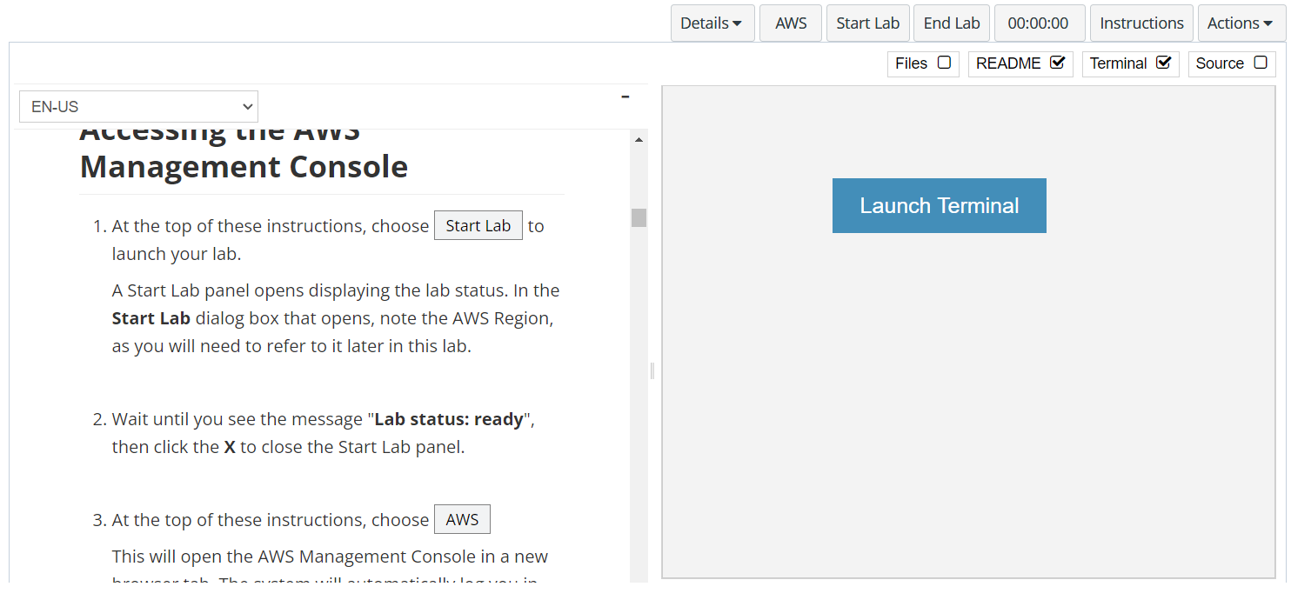
In aws labs click on start lab

Slide 4
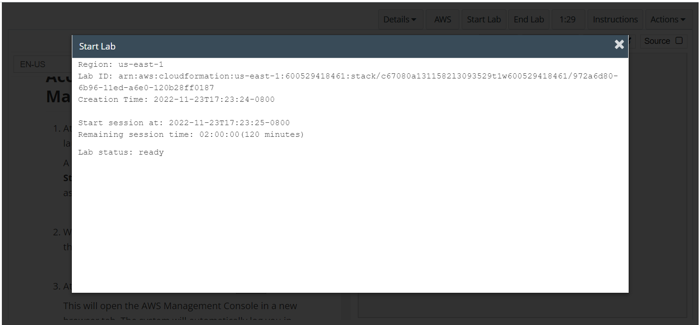
Wait to see lab ready status in the window then press x and click on aws to launch console

Slide 5
Task 1 : Creating a security group to access your EFS file system

Slide 6
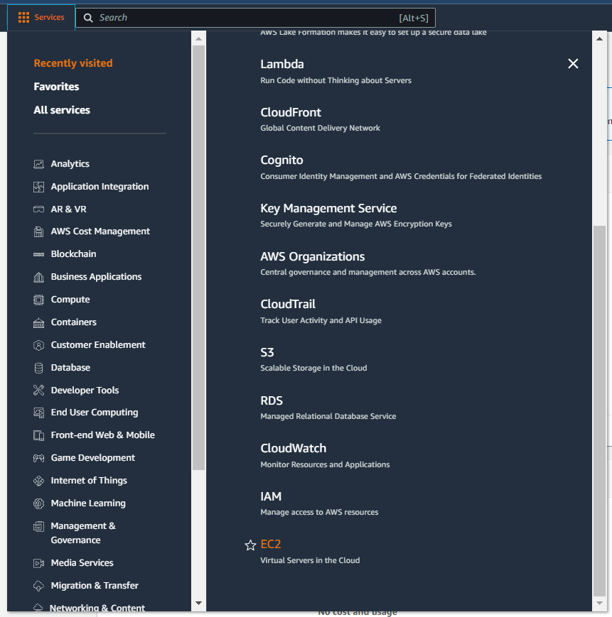
Select services and then click on ec2 button
Click on the Services button
Click on the EC2 button

Slide 7
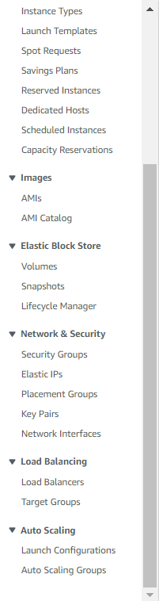
CHOOSE security groups IN THE NAVIGATION PANE
Click on security groups button

Slide 8
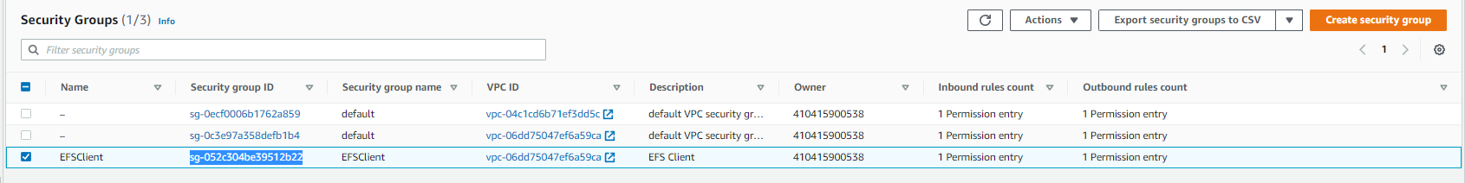
Copy the security group id for efs client and then click on create security group button

Slide 9
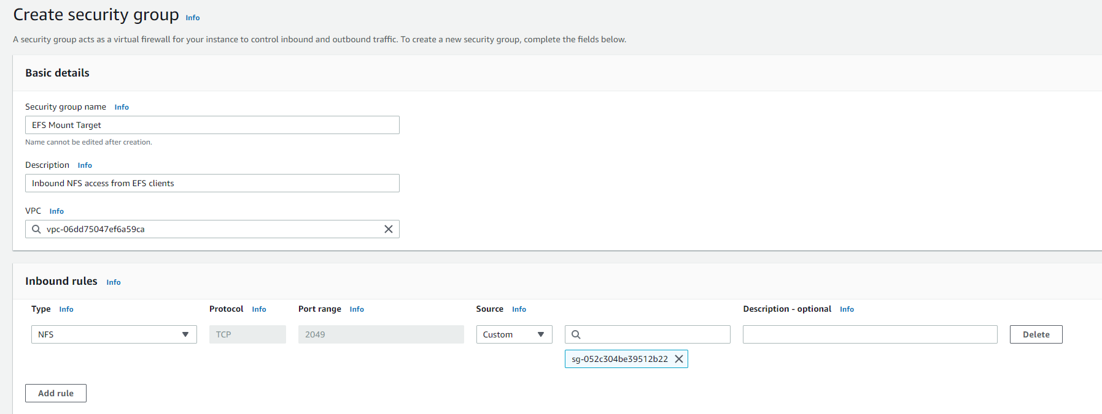
Set the properties for the security group as mentioned in aws labs along with adding the inbound rules, then click on create security groups

Slide 10
Task 2 : Creating an EFS file system

Slide 11
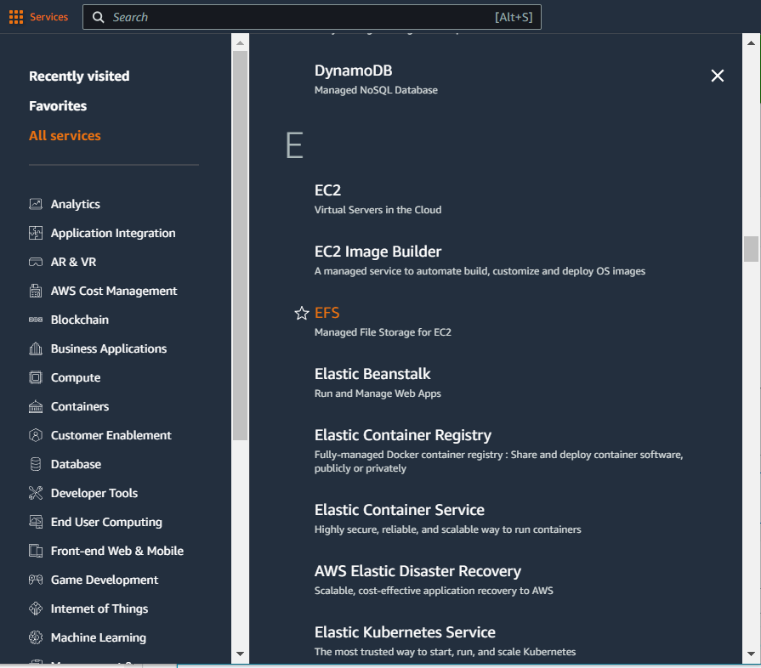
In the services menu select efs

Slide 12
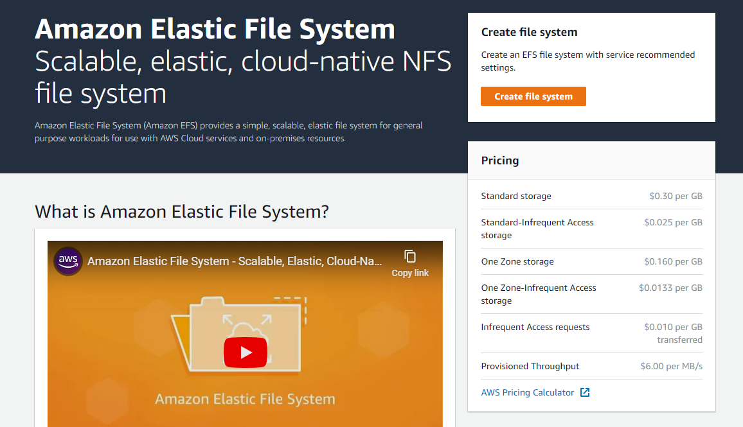
On the efs page click on create file system button
Click on create file system

Slide 13
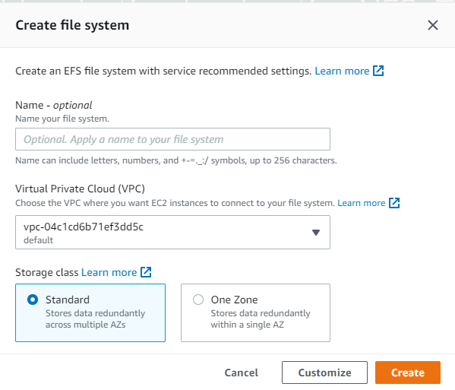
Choose customize button

Slide 14
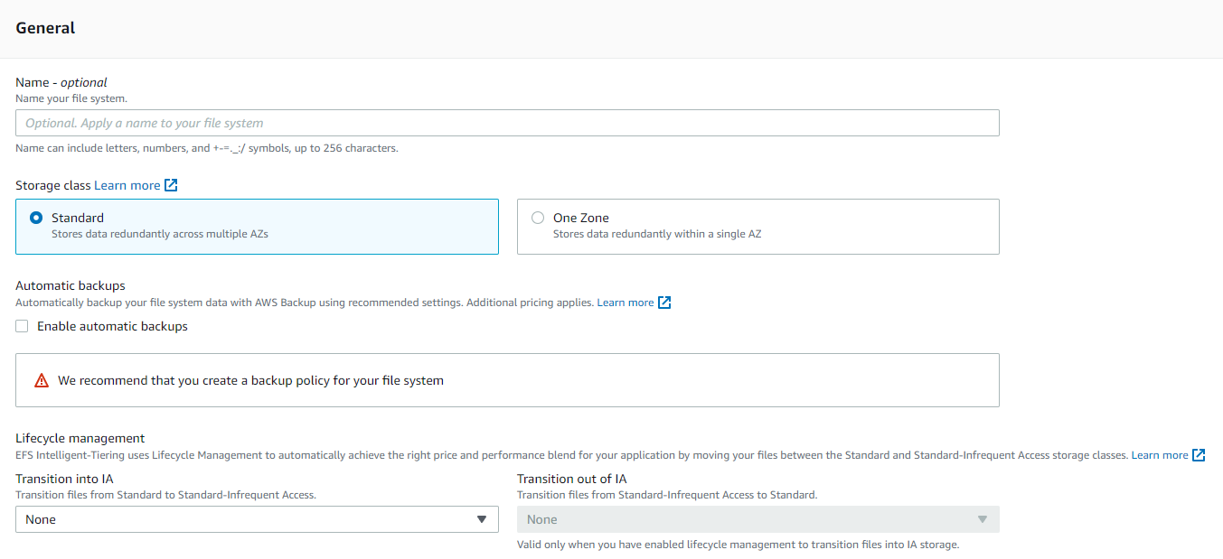
Uncheck ‘enable automatic backups’ and change lifecycle management rules to none
Uncheck the tick box
Choose none from the dropdown

Slide 15
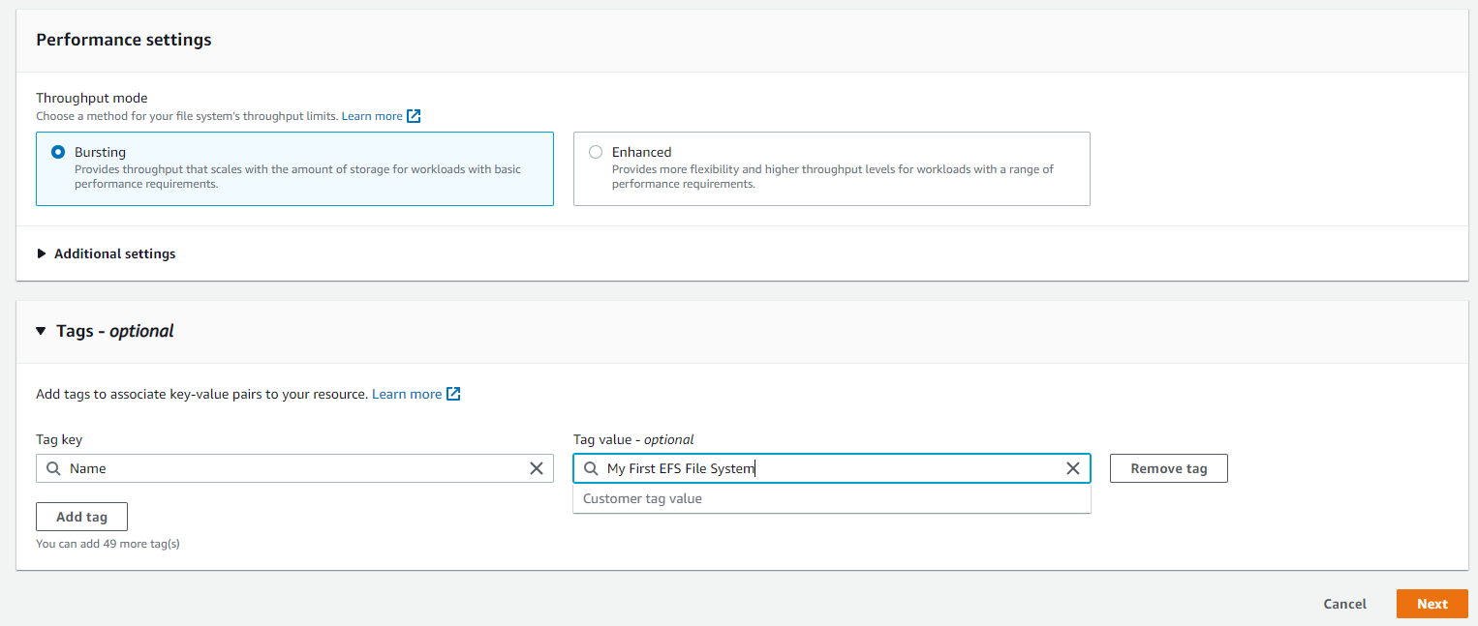
Add the tags mentioned in the lab and then click next

Slide 16
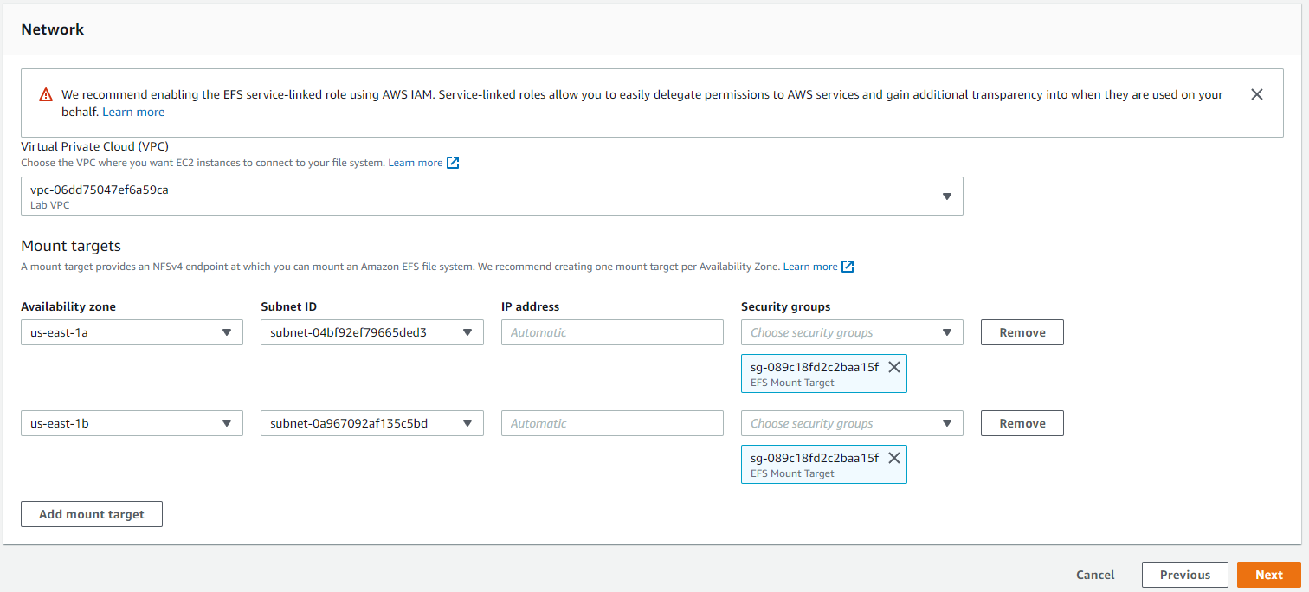
Choose lab vpc, remove the default security groups by clicking x and then select the efs mount target security groups, then click next
Choose lab vpc
Remove the original security group and add EFS mount target

Slide 17
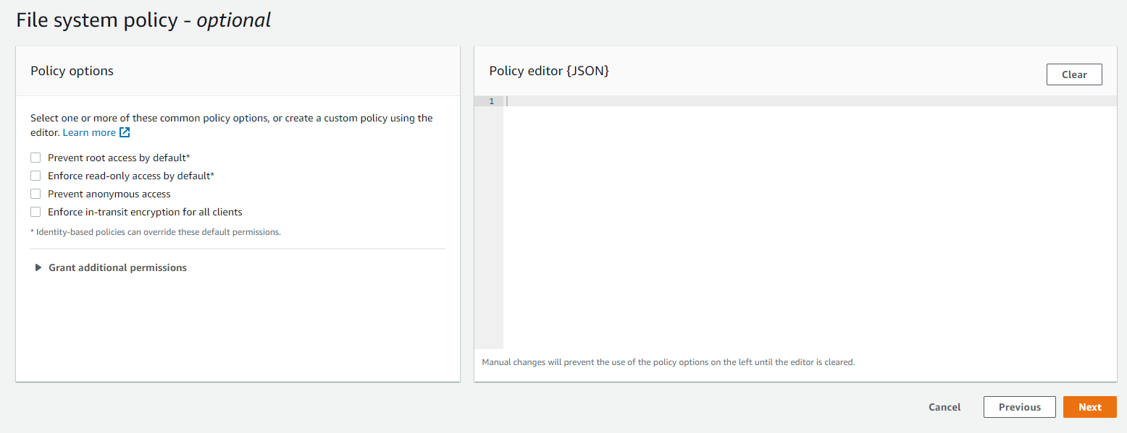
Choose next

Slide 18
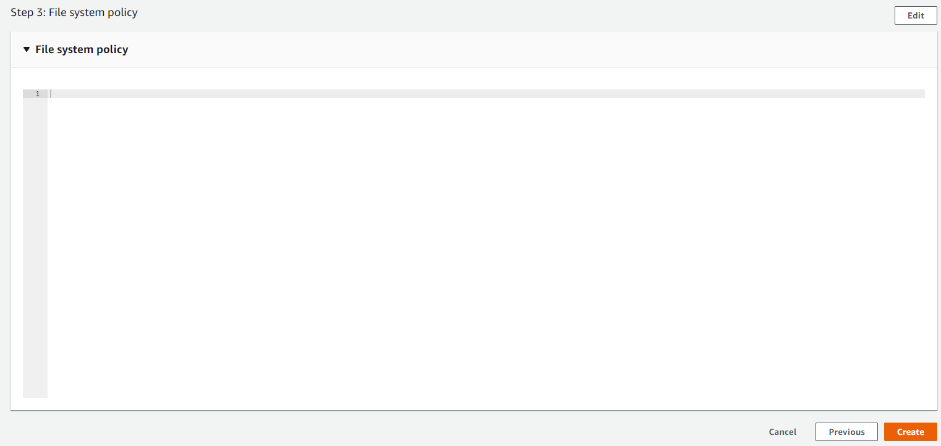
Review the vpc settings and click create

Slide 19
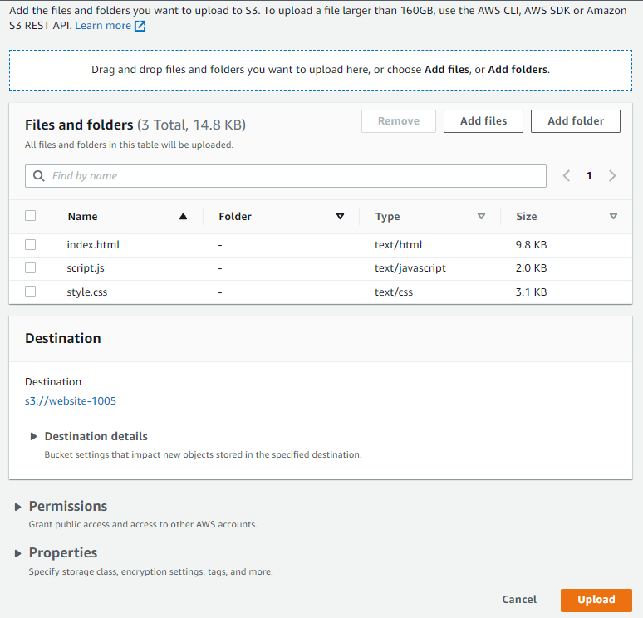
add the 3 files and click upload

Slide 20
Task 3 : Enabling access to the objects

Slide 21
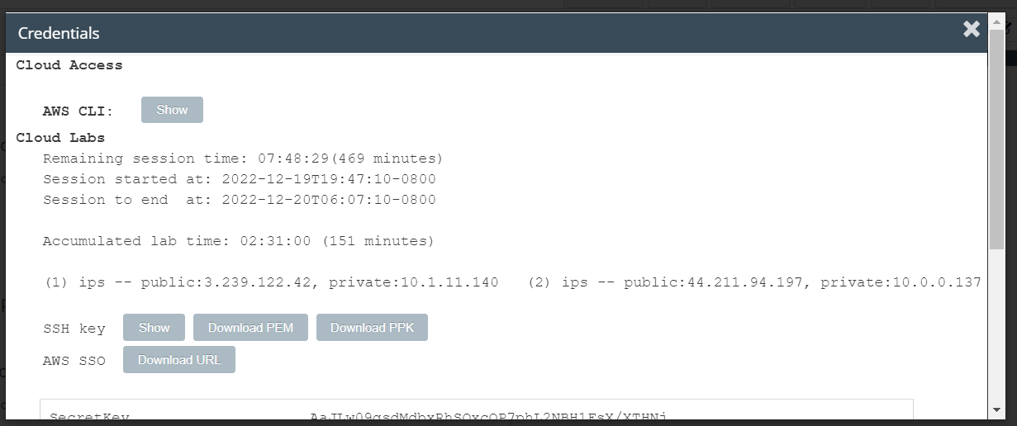
Download the ppk file by clicking on details > show > download ppk FILE

Slide 22
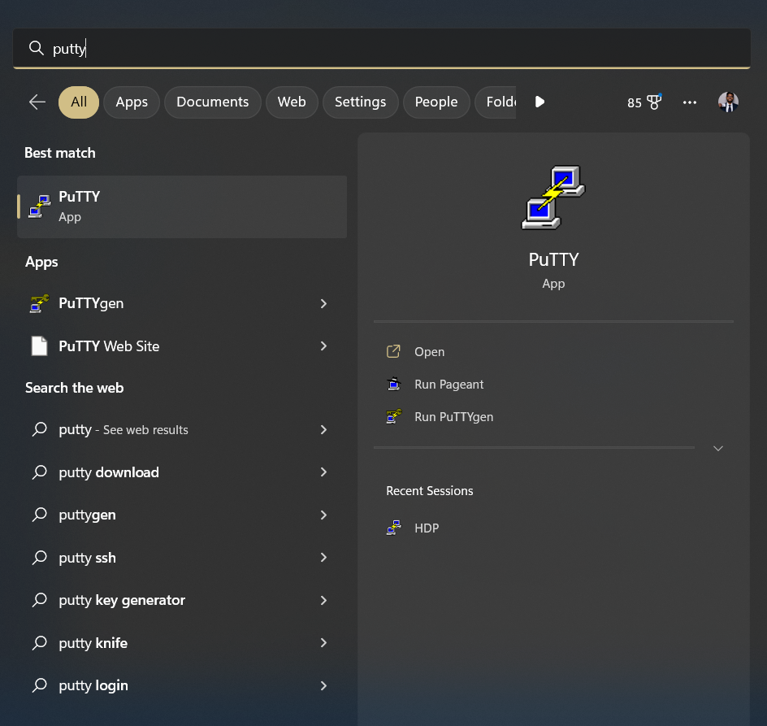
FOR WINDOWS DOWNLOAD PUTTY AND SEARCH FOR PUTTY

Slide 23
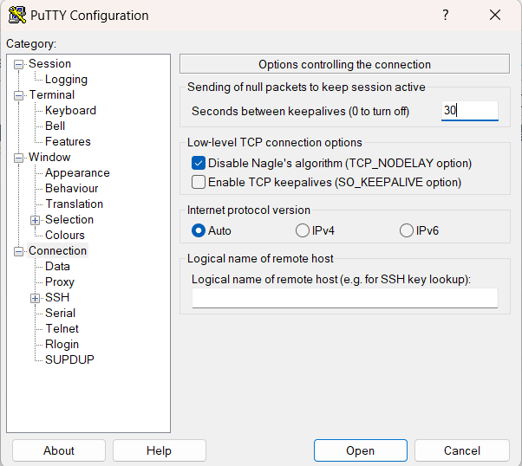
CONFIGURE TIMEOUT AS 30 IN CONNECTIONS

Slide 24
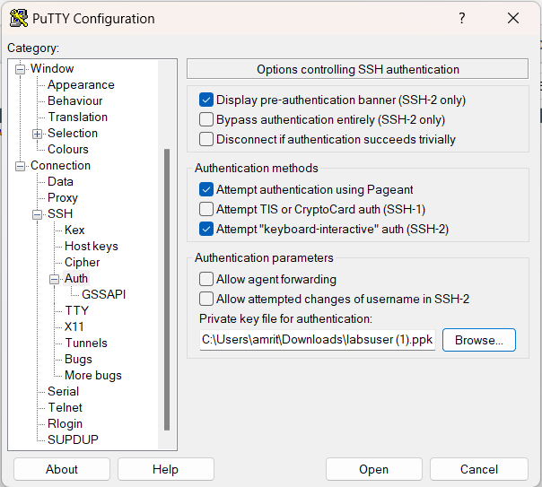
Add the ppk under ssh > auth and then private key file for authentication, then click open

Slide 25
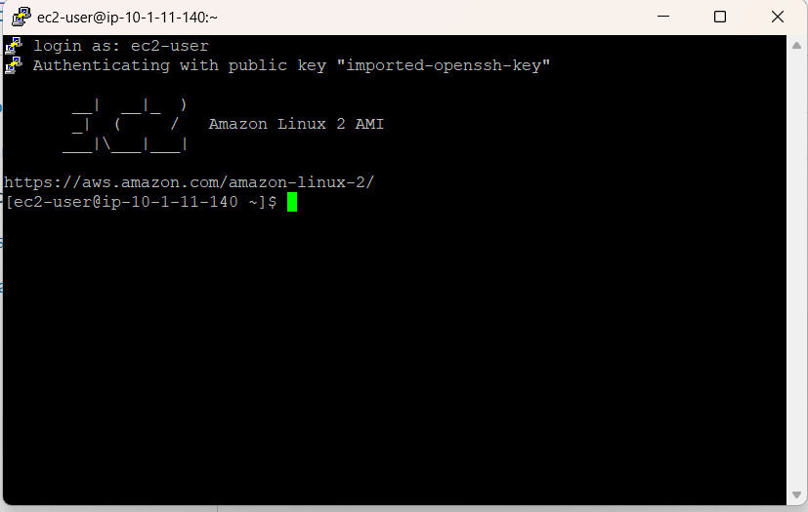
LOGIN WITH EC2-USER IN THE TERMINAL

Slide 26
Task 4 : Creating a new directory and mounting the EFS file system

Slide 27
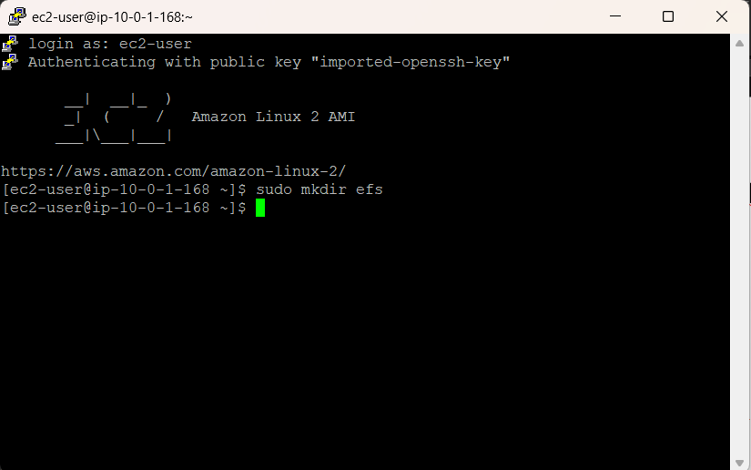
Use sudo mkdir efs TO CREATE A NEW DIRECTORY

Slide 28
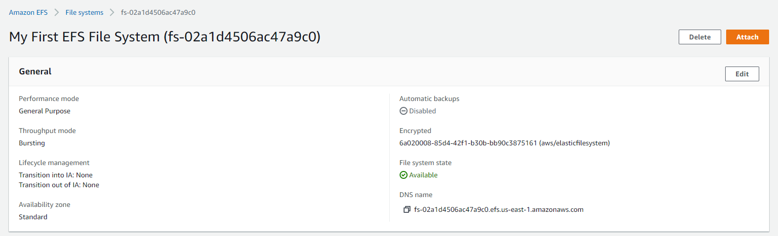
ATTACH THE efs FILE SYSTEM BY OPENING EFS FILE SYSTEM

Slide 29
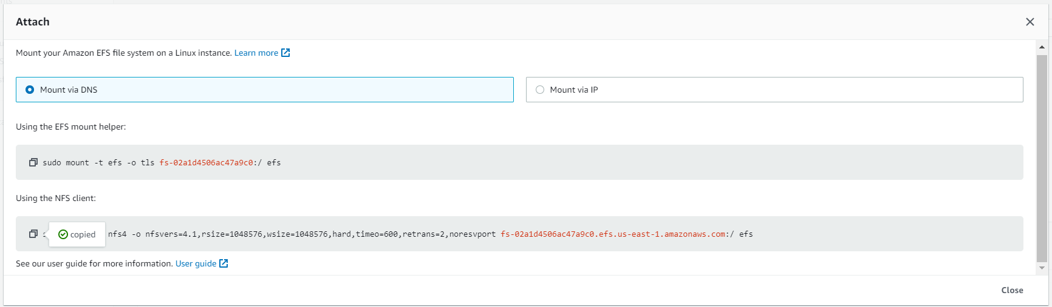
ON OPENING THE ATTACH INSTRUCTIONS AND COPY THE NFS CLIENT INSTRUCTIONS

Slide 30
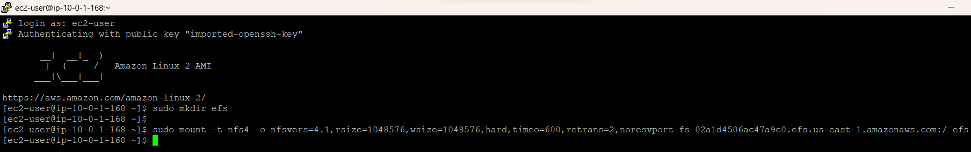
PASTE THE COMMAND IN THE PUTTY CLIENT

Slide 31
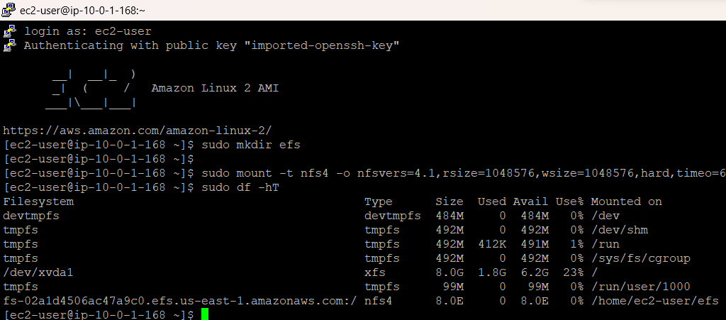
RUN SUDO SD-HT FROM AWS LABS TO RUN ON PUTTY

Slide 32
Task 5 : Examining the performance behavior of your new EFS file system

Slide 33
RUN SUDO SD-HT FROM AWS LABS TO RUN ON PUTTY

Slide 34
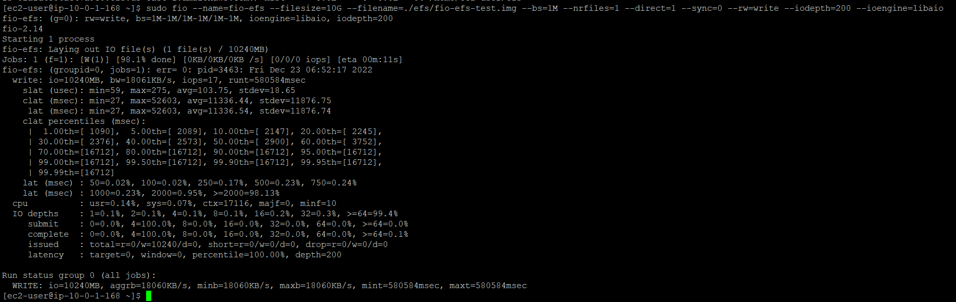
RUN THE COMMANDS FROM AWS LABS TO TEST THE READ/WRITE OUTPUT

Slide 35
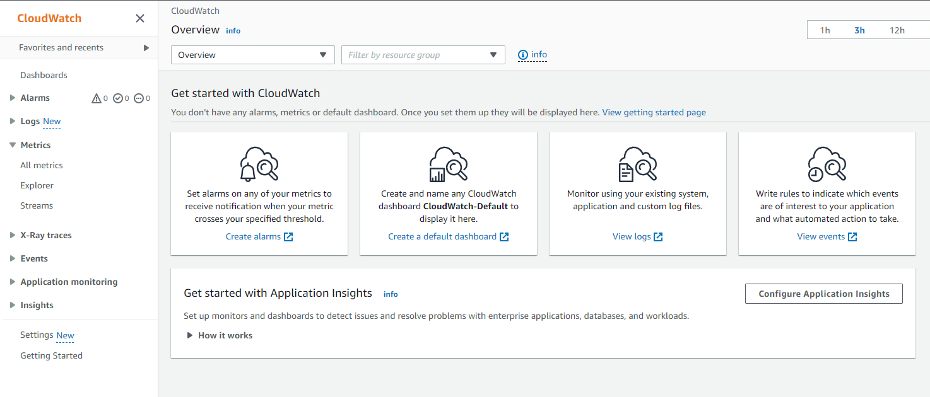
CHOOSE ALL METRICS IN THE NAVIGATION PANE

Slide 36
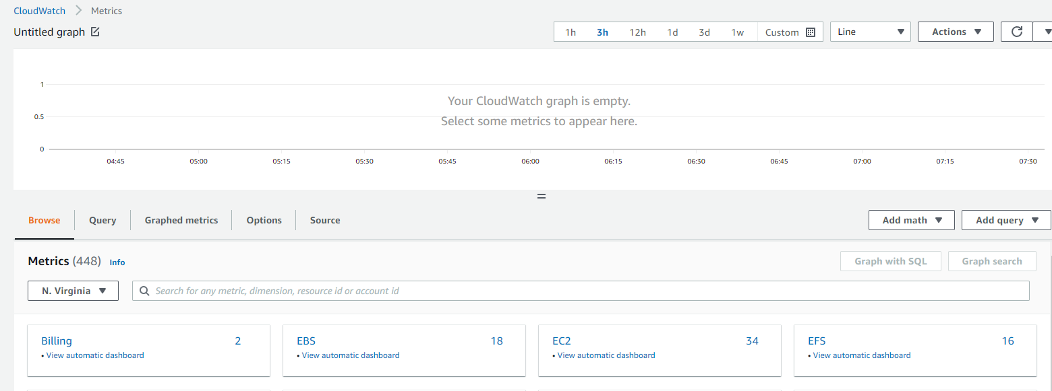
CHOOSE EFS IN THE METRICS PAGE

Slide 37
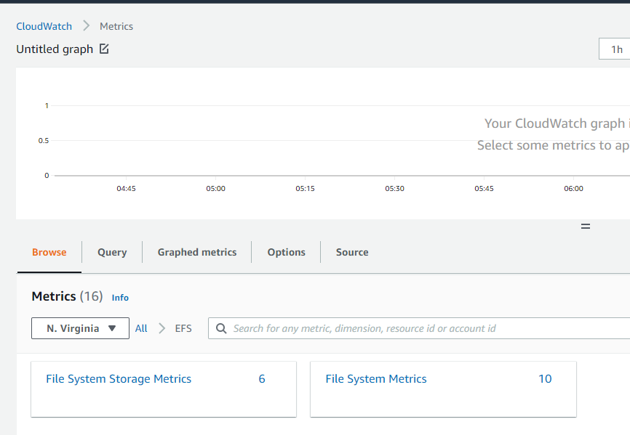
CHOOSE FILE SYSTEM METRICS IN EFS

Slide 38
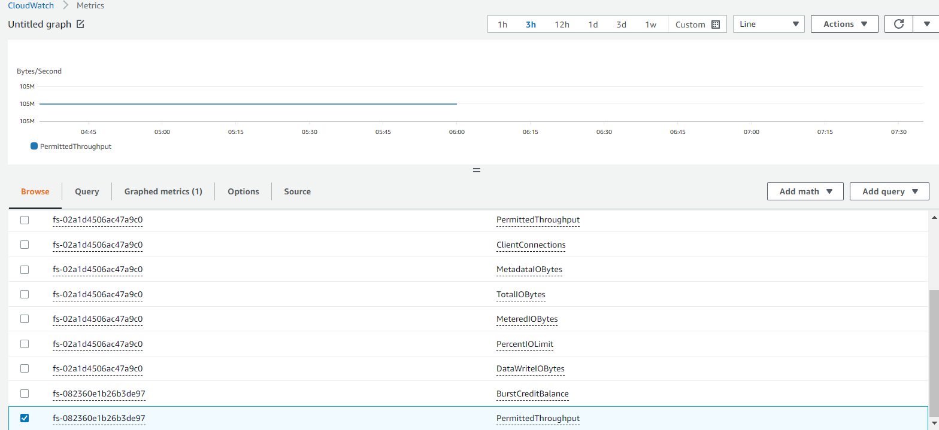
SELECT PERMITTED THROUGHPUT METRIC AND WAT FOR THE CHART TO POPULATE, FOLLOW THE STEPS IN AWS LABS TO GENERATE THE REQUIRED GRAPH

Slide 39
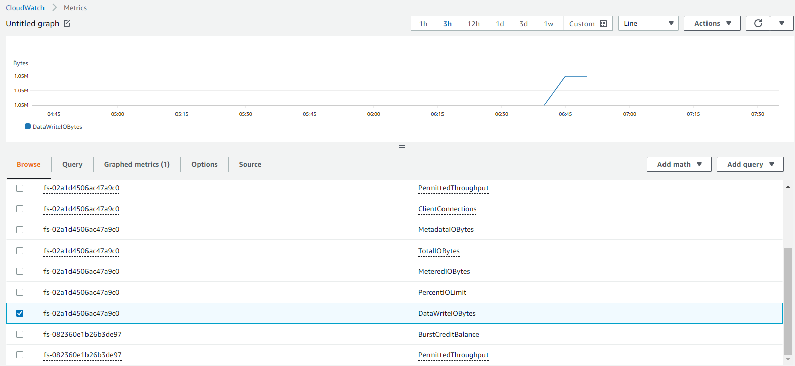
CHOOSE DATawriteiobytes in the metrics available after unchecking the previous metric

Slide 40
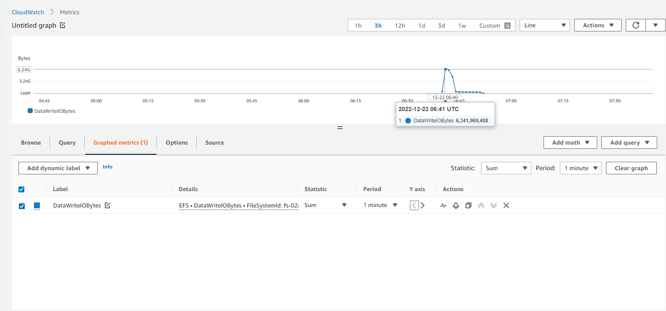
Select graphed metrics > set statistic as sum > select period as 1 minute, divide it by 60 to get throughput

Slide 41
THANK YOU
Amrit Singh

